Slide 1

IBM Application Integration
Integrate data, applications and processes across hybrid cloud
Speaker name
January 2025

Slide 2
Today’s talk Integrate data, applications and processes across hybrid cloud
1
Turn integration into your competitive advantage
Integration is a business imperative. The ability to integrate apps & data rapidly with agility becomes a driving force for growth
2
Key areas we're focusing on with clients and partners
Centrally manage distributed integrations and drive AI productivity for better customer experiences​
Modernize your API management and event-driven architecture for enhanced customer experiences
3
Why IBM for application integration
Develop anywhere, deploy everywhere with seamless integration, robust API management, and AI-driven workflows.
Comprehensively support and unify all styles of integration —applications, APIs, events, B2B, and files—to provide end-to-end visibility, monitoring, management and metering.

Slide 3
82% of enterprise leaders say IT complexity is impeding success
Is IT Complexity Standing in the Way of Your Organization’s Growth?, Harvard Business Review, 09 December 2022.
Notes:
82% of enterprise leaders say IT complexity is impeding success

Slide 4
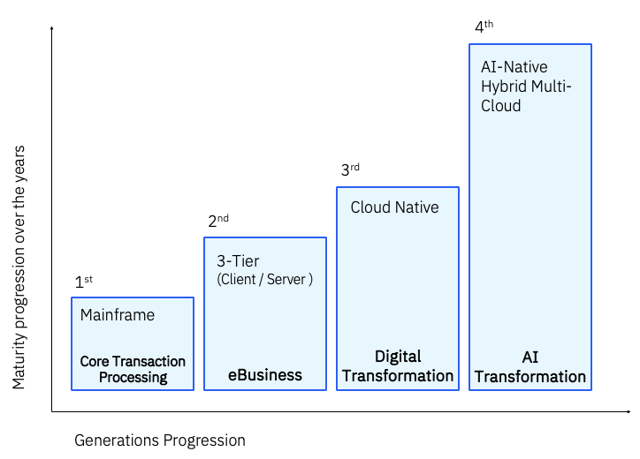
1B
new applications are expected by 2028
Integration, APIs and data are essential to success in the paradigm shift to hybrid and multicloud AI transformation.
1 Billion New Logical Applications: More Background, IDC, April 2024.
Notes:
Meanwhile, the landscape is not getting any simpler. Digital transformation itself has evolved, and we are seeing a paradigm shift to hybrid, multi-cloud, AI-driven transformation. Integration, APIs, and data are linchpins in this evolution.
1 Billion New Logical Applications: More Background - Printer-friendly - US51953724 (idc.com)
1 Billion New Logical Applications: More Background (idc.com)

Slide 5
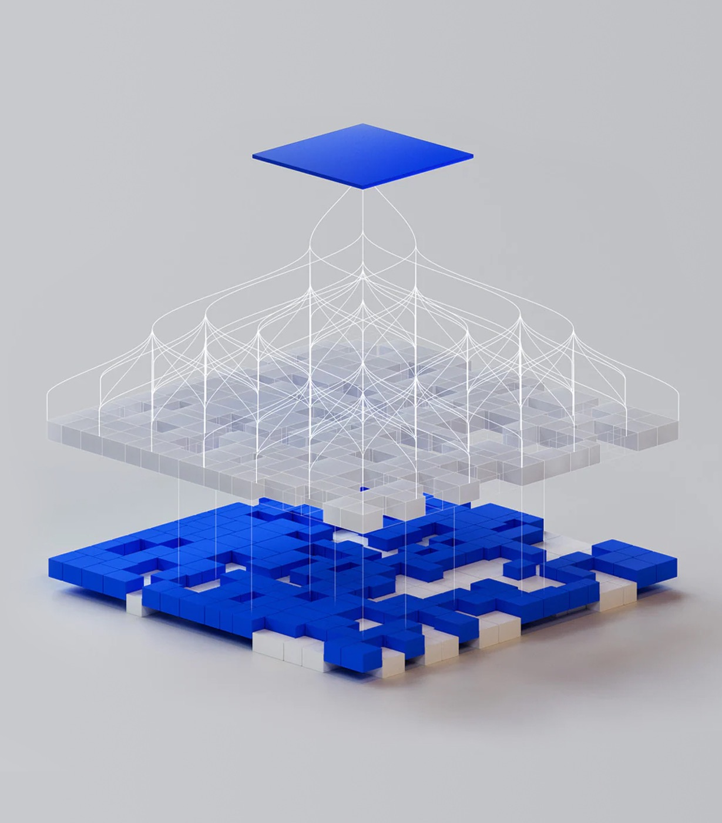
Years of digital transformation have resulted in more complexity than ever
The technology fueling transformation has inadvertently created a chaos of connectivity.
Vendor sprawl
Siloed systems and data
Diverse geographies and clouds
Explosion in apps, APIs, events, data and files, and B2B partners (now amplified by AI)
Notes:
It's never been more complex. Opportunity and challenges are greater than ever. Current technology is only exacerbating the problem. It’s unsustainable.
Point integration solutions create islands and more siloes, increase operational costs and limit innovation
Diverse geographies & clouds
Private, public, hybrid
AWS, Azure, IBM
Legacy and new

Slide 6
Integration challenges can have a lasting business impact
Disconnected systems and data silos hinder seamless integration
Fragmented systems, data silos, multiple IT vendors and restricted cloud access to legacy or on-premises systems pose challenges in leveraging modern services, leading to increased costs, reduced productivity and hindered customer experience enhancements.
Lack of API visibility, inconsistent management and security gaps
The limited visibility of APIs makes tracking and managing them difficult, and inconsistent lifecycle management leads to duplication, poor performance and outdated services. Unmanaged APIs with security gaps increase risks like data breaches and cyberattacks.
Lack of speed and agility in adoption of event-driven approaches
Organizations often find themselves compounded by duplication of events and locked into proprietary solution stacks, limiting their flexibility and integration capabilities and making it challenging to identify important events and patterns that could inform strategic decisions.
The hidden costs of ignoring application modernization
Ignoring application modernization can lead to increased costs, inefficiencies, security risks and a poor user experience, ultimately jeopardizing an organization’s competitiveness and ability to thrive in a rapidly evolving business landscape.
Notes:
When integration works – everything hums along and the business can thrive.
When integration isn't working well, the business suffers. It shows up in long lead times to support innovation, inability to deliver on SLAs, massive vendor sprawl as patchwork solutions come into play. It means pilot projects never scale, and exciting opportunities always fall behind business-as-usual.

Slide 7




Is integration a competitive advantage for your organization?
Integration should be a key enabler of business success, helping you move faster and overcome challenges
Continual change
Cybersecurity threats
Economic challenges
Regulatory requirements
Notes:
Integration is an enabler – allows you to move faster, toward whatever it is your organization is trying to achieve.
When done well, integration can be a competitive advantage.
You exist in an environment of constant change, new and emerging security threats, shifting economic challenges, and complicated regulatory requirements.
Integration plays a role in each of these areas.

Slide 8

How does integration accelerate innovation and modernization?

Slide 9
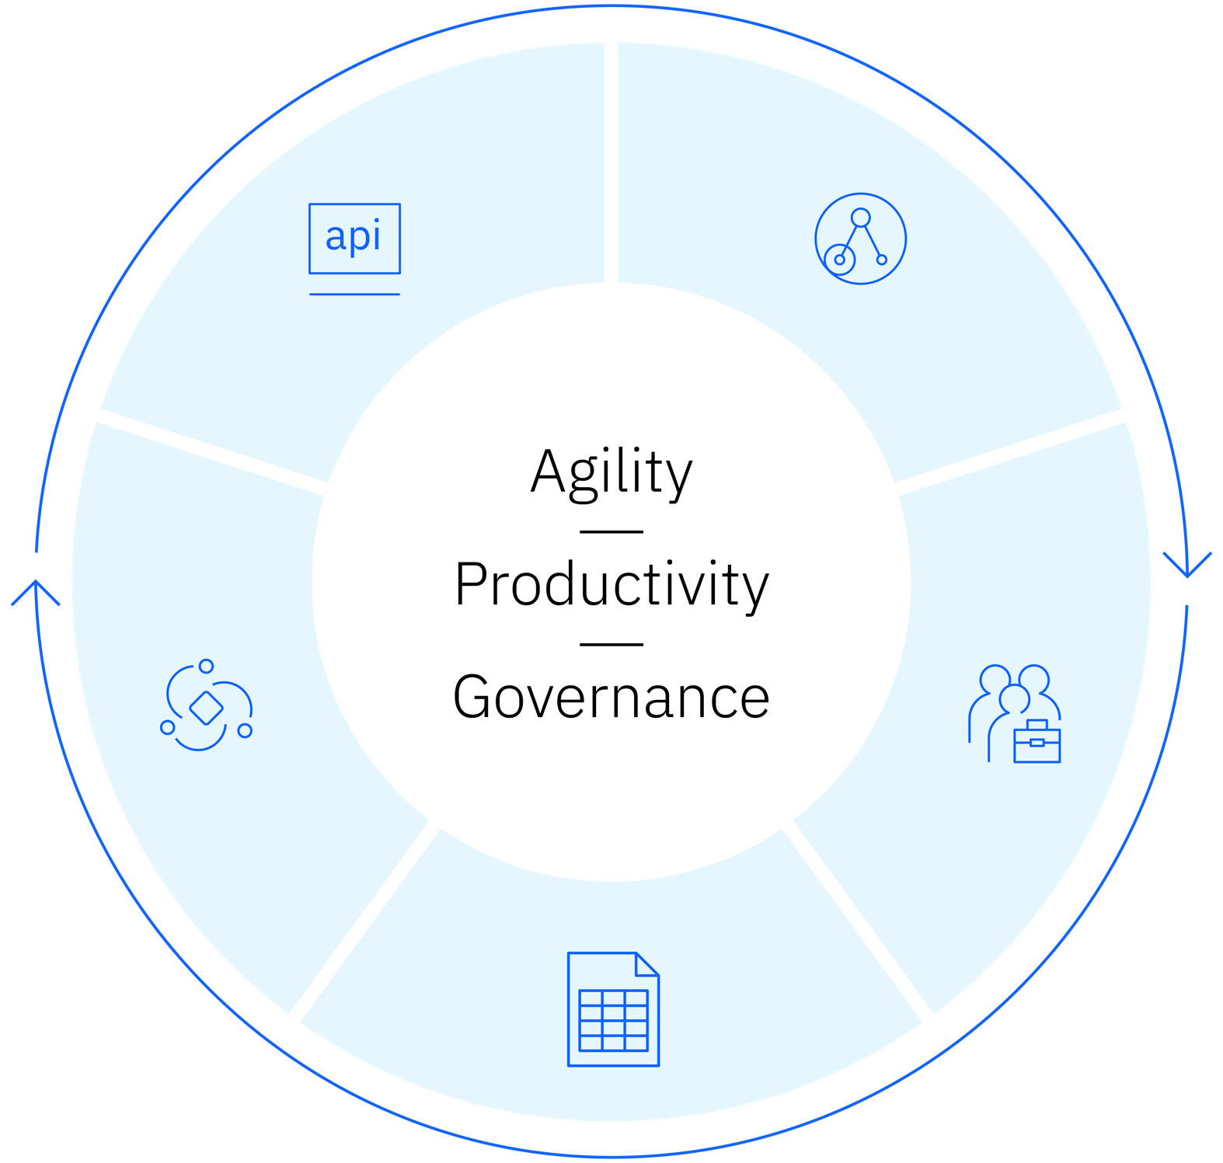

Empower seamless integration and automation with IBM’s hybrid iPaaS
IBM’s hybrid iPaaS is a unified hybrid integration platform as a service with a single, common interface and control plane for multiple integration patterns—applications, APIs, B2B, files and events—to help enterprises accelerate innovation, derive value from data, infuse AI and modernize their applications.
IBM’s iPaaS aggregates integration technologies to offer multiple advantages:
A unified experience
The ability to develop anywhere, deploy anywhere
Centralized management and distributed execution
Composable integration flows
AI-driven productivity
APIs
Applications
Build
Govern
Anticipate
Hybrid control
Events
B2B
Files
Notes:
Let’s take a step back and talk about how to manage integration from a comprehensive viewpoint.
IBM’s iPaaS is revolutionizing integration by bringing forth a unified hybrid integration platform as a service (iPaaS) that helps you streamline connections, enhance real-time data flow, and simplify operations.
The iPaaS allows for the composition of applications and automation across various endpoints. A unified integration platform integrates various systems, applications, and data sources through its robust support for a wide range of integration protocols and connectors, enabling seamless data exchange across different environments.
It automates repetitive integration tasks such as data synchronization using features like drag-and-drop workflow creation and significantly reducing the complexity and time required for setting up integrations.
The platform provides a user-friendly low code and no code interfaces that simplifies the management of integration workflows. This includes a visual design environment for creating, managing, and monitoring integration processes, making it accessible even for non-technical users.
The platform supports deployments across multiple cloud providers and on-premises systems, giving organizations the flexibility to choose the best environment for their needs. This includes seamless integration with leading cloud platforms like AWS, Azure, Google and IBM Cloud.
A platform approach to integration saves time, reduces rework and eliminates siloed data that hampers growth. It allows organizations to stay agile and innovative with seamless integration for apps, APIs, B2B, files, and event streams, ensuring continuous growth. Stop drowning in digital transformation and start saying “yes” to innovation.

Slide 10








Rapidly create, manage, secure and socialize APIs
IBM API Management solutions uses an intuitive experience to help consistently create, manage, secure, socialize and monetize APIs, which promotes digital transformation on premises and across clouds.
Create and test
Iteratively develop and test APIs rapidly with the intuitive API editor and AI-powered testing, thereby unlocking data, applications and services using open standards.
Manage
Package, publish, promote and reuse APIs across environments with full-lifecycle control throughout.
Secure
Easily apply built-in and extensible policies to secure, control and mediate the delivery of APIs with scalable enterprise-grade gateways.
Socialize
Empower API consumers with integrated portals to discover, test and consume APIs, building a digital brand and community.
API 2.0
The next generation of APIs brings together numerous API types from GraphQL to events, increasing endpoints across the organization and security requirements.
Unified management of all API types
AI gateway
Infuse APIs
everywhere
API assistant
Notes:
IBM delivers all the capabilities of API Lifecycle Management through, IBM’s flagship product, API Connect. This includes the ability to “Create, Manage, Secure, and Socialize” APIs across multiple clouds and hybrid use cases. All leveraging IBM market leading gateway technology, DataPower, recognized for its security and performance.

Slide 11

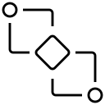

React to events in real time for greater responsiveness and agility
IBM Event Automation puts business events to work by enabling users to detect situations, act in real time, automate decisions and maximize their revenue potential.
Event streams
Collect streams of real-time business events with enterprise-grade Apache Kafka.
↓
Event endpoint management
Build a self-service catalog of event sources for users to securely browse and utilize.
↓
Event processing
Define business situations in an intuitive, easy-to-use authoring canvas to act in real time and automate decisions.
↓
Benefits
Empower a broad range of users
Less-technical users can work with real-time events to detect and automate business situations using their existing skill set.
Facilitate sharing and reuse of events
IT teams can provide self-service access to events while retaining proper controls and good governance.
Extend existing infrastructure
Enterprise architects can extend existing event-driven investments with composable capabilities.

Slide 12
Modernize your existing applications
How will the AI-driven surge in new applications impact your legacy Java application estate?
For innovation and modernization, you will need Java 17 and higher
Java 8 end of life
29% of applications still use Java 8, which ends community support in 2026.¹
Spring Framework community support for Java 8 ended August 2024.²
Evolving on your apps
Keep on Java 8 what you can
Modernize what you must
Build the innovative solutions needed
How?
IBM and Red Hat are offering new, more cost-effective and safer options.
Preserve
Modernize
Preserve Java 8 indefinitely
Java 17 in WAS-ND cell (Keep your scripts!)
Java 17 SaaS in the cloud
AI-based discovery and app code update tooling
2024 State of the Java Ecosystem,, DD Month 20YY.
Java 8 will no longer have open community support after 2026, 30 October 2024

Slide 13







Why IBM
Develop and deploy integrations anywhere
Work how you like and eliminate duplicate efforts.
Unified experience across all iPaaS components
Simplify learning as well as managing and collaborating across APIs, apps, B2B and events.
Central control, distributed execution
Manage integrations across the business from a single platform, improving visibility and control across operations, eliminating silos and streamlining processes.
Composable business architecture
Deliver faster thanks to the enhanced agility made possible by a flexible set of building blocks.
AI-driven productivity
Leverage AI in IBM’s iPaaS to optimize workflows, reduce manual effort and gain smarter insights for decision-making.
Comprehensive API security and governance
Innovate across your business to improve speed and agility while reducing business costs and risks with our market-leading and award-winning API management solution.
Event-driven architecture for real-time speed and agility at scale
Make business events available where they’re needed thanks to architecture built on open-source technologies like Apache Kafka.
Notes:
It's not just any iPaaS that can deliver a true competitive advantage.
IBM's hybrid iPaaS does this in five key capabilities:
Central control, distributed execution: for easier compliance and better control of your integration landscape with a unified control plane
Develop anywhere, deploy anywhere: Work how you like and eliminate duplicate effort
Unified experience across all iPaaS components: Simplify learning, managing, and collaboration across apps, APIs, B2B and files
Composable business architecture: Be able to turn on a dime with a flexible set of building blocks that lets you deliver faster
AI-driven productivity: Improve productivity with generative AI across the integration lifecycle

Slide 14
Turn integration into your competitive advantage
Agility
Adapt quickly and work the way you want to
Flexibility for personas, deployment models and integration types
Productivity
Leverage AI to allow for more done together, with less work
AI assistants and autonomous AI, abstract backends, common UX
Governance
Grant autonomy with guardrails while ensuring enterprise-grade security
Data sovereignty, multivendor management, centralized control
Notes:
When integration is turned into a competitive advantage, it can fuel real business results. We see this centered around three key benefits: Agility, Productivity, and Governance.
Agility
Enables quick adaptation and flexible working methods. Today’s rapidly shifting landscape requires agility across data and applications to take advantage of events and opportunities. It also means more flexibility for personas, deployments, and integration types
Productivity
Allows more users to accomplish more with less effort, working collaboratively and leveraging AI in tangible ways. To innovate and differentiate in the market, you need to rapidly deliver new digital services and eliminate bottlenecks.
Governance
Provides organizational empowerment without added stress. Increased regulation and unchecked decentralization demands autonomy with guardrails while ensuring enterprise-grade security

Slide 15



IBM integration solutions in action
Komatsu Australia used IBM webMethods to create a seamless digital experience allowing customers, partners and internal teams to access the right data at the right time to become a data-driven business.³
Benefits
Teams recorded 30% faster development
Time for single file-source integration into the new architecture reduced from 5 days to 1
IBM achieves big productivity wins by implementing a centralized API management solution.⁴
Benefits
Reduced API costs by 50%
50% faster solution delivery time
In Norway, Norsk Tipping uses the IBM Event Streams platform to accelerate data processing and deliver more responsive user services.⁵
Benefits
Processing lottery subscriptions under Event Streams is 6x faster than before
In a busy period, Norsk Tipping must process more than 5,000 gaming transactions per second
Moving mountains with cloud integration, IBM, 20 September 2024.
Reducing API costs by 50%, IBM, 18 April 2024.
Improving the gaming experience with event streaming technology, IBM, 14 May 2024.
Notes:
https://www.ibm.com/case-studies/komatsu-Australia
https://www.ibm.com/case-studies/ibm-cio-office-api
https://www.ibm.com/case-studies/norsk-tipping

Slide 16
The Total Economic Impact of IBM Integration by Forrester Consulting
176%
ROI
Plus, unquantified benefits such as ease of use, reduced training costs, and improved visibility and security posture
33-66%
time savings
Over 3 years and 135 projects, the shorter development cycle is worth a risk-adjusted $1.2M
(33% for complex projects; 66% for simple projects)
40%
downtime reduction
Over 3 years, the improved reliability saves the composite organization a risk-adjusted $1.3M in downtime costs
<6 months
payback period
Cash flow analysis shows that the breakeven point occurs in months, not years
Notes:
Forrester TEI on economic impact of IBM Integration

Slide 17











IBM Software
Hybrid Cloud
Transaction Processing
Automation
Data
Unify on-prem, public, private clouds and edge to scale virtualization and AI across environments
Deliver unmatched transactional performance, security and reliability
Automate technology lifecycle management with AI for productivity, resiliency and spend optimization
Use trusted and performant data to enhance insights and AI
Open and Trusted
Notes:
IBM uniquely understands the complexity and high standards inherent in enterprise technology environments. Our software helps enterprises make the most of their technology and is infused with a common core of AI capabilities​
Hybrid Cloud: Unify on-prem, public, private clouds and edge to scale virtualization and AI across environments​
Transaction processing : Deliver unmatched transactional performance, security and reliability​
Automation: Make technology lifecycle management your advantage—with AI-powered automation
Data: Use trusted and performant data to enhance insights and AI​
We’re the only company that can build, deploy and manage for hybrid cloud and AI.
Each of our software platforms is composed of core capabilities. Let’s walk through Automation in more detail​.

Slide 18



Automation
Automate technology lifecycle management with AI for productivity, resiliency and spend optimization
Application Development and Integration
Infrastructure Automation
Technology Business Management
Connect teams, data, and technology to modernize, innovate and automate your systems and applications for faster, more efficient development at scale
Unlock developer productivity and lower the risk of breaches for more resilient and secure infrastructure and faster time to market with AI-enhanced capabilities
Reduce cloud waste, application risk, gain visibility of IT spend, and proactively resolve issues for better uptime and user experiences with AI-enhanced capabilities
– Application Development – Application Integration
– Infrastructure Lifecycle Management – Identity & Access Management – Network Management
– Observability – FinOps – IT Financial Management – Asset Lifecycle Management
Notes:
Digital business success requires continuous management and optimization of technology investments and application performance. Yet, modern hybrid cloud architectures introduce complexity—siloed data, system outages, and wasted resources—that manpower alone cannot resolve. This generates exciting new opportunities for AI-powered automation. ​
IBM’s automation platform helps your teams realize the untapped potential of their IT and operations. We do this with AI-powered automation and tools across the build, deploy and manage phases of the technology lifecycle, enabling you to reinvent core processes for innovation, reinvest savings from efficiencies into growth initiatives, and redeploy talent to areas of greatest impact​
Application Development and Integration: Connect teams, data, and technology to build, modernize, innovate and integrate your systems and applications for faster, more efficient development at scale​
Accelerate developer and integration productivity with AI-assisted tooling in Hybrid iPaaS and API Connect. Develop anywhere, deploy everywhere with seamless integration, robust API management and AI-driven workflows – from code creation and test case generation to documentation.​
Use AI to map and modernize your Java apps and cloud-native runtime environments with microservices, Kubernetes or SaaS.​
Infrastructure Automation: Unlock developer productivity and lower the risk of breaches for more resilient and secure infrastructure and faster time to market with AI-enhanced capabilities​
Automate hybrid network provisioning, configuration and management for implementation efficiency, including the last mile.​
Seamlessly integrate security across networks, infrastructure and applications with Verify, without impacting user experience.​
Drive cross-platform integrations of existing network resources to save time, improve efficiency, and enhance collaboration.​
Technology Business Management: Reduce cloud waste and application risk, gain visibility of IT spend, and proactively resolve issues for better uptime and user experiences with AI-enhanced capabilities​
Efficiently manage and maximize the value of every dollar spent on IT, OT, and AI in any cloud environment with enhanced financial visibility delivered by Apptio and Cloudability.​
Proactively remediate issues with AI-enabled full-stack observability and actionable intelligence from Concert, Instana and Turbo.​
Optimize IT/OT asset lifespans to reduce costs, risk and energy consumption, with Maximo and AI-generated failure codes. ​

Slide 19







































Automation
Automate technology lifecycle management with AI for productivity, resiliency and spend optimization
Application Development and Integration
Infrastructure Automation
Technology Business Management
Connect teams, data, and technology to modernize, innovate and automate your systems and applications for faster, more efficient development at scale
Unlock developer productivity and lower the risk of breaches for more resilient and secure infrastructure and faster time to market with AI-enhanced capabilities
Reduce cloud waste, application risk, gain visibility of IT spend, and proactively resolve issues for better uptime and user experiences with AI-enhanced capabilities
Application Development
Application Integration
Infrastructure Lifecycle Management
Identity & Access
Management
Network
Management
Observability
FinOps
IT Financial Management
Asset Lifecycle Management
Enterprise Application Service for Java
Hybrid iPaaS
Terraform
Verify
NS1®
Concert®
Cloudability®
Apptio™
Maximo® Application Suite
API Connect®
Consul
Hybrid Cloud Mesh
Instana®
Kubecost
Targetprocess
Envizi™ ESG Suite
Nomad
Turbonomic®
SevOne®
Environmental Intelligence
Vault
Rapid Network Automation
HashiCorp acquistion pending
Notes:
Similar view that layers on a representative set of our actual products.

Slide 20



Learn how IBM can help you turn integration into a competitive advantage
Learn more about IBM application integration solutions
Learn more about iPaaS and access the buyer’s guide
Learn more about API Connect
Learn more about Event automation
Notes:
This slide is self-explanatory and does not require speaker notes.

Slide 21
Notes:
This slide is self-explanatory and does not require speaker notes.

